Slide 1
How Inkjet Printers Work

Slide 2

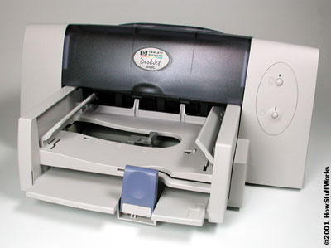
How Inkjet Printers Work
An inkjet printer is any printer that places extremely small droplets of ink onto paper to create an image. If you ever look at a piece of paper that has come out of an inkjet printers ,you know that:

Slide 3
-The dots are extremely small (usually between 50 and 60 microns in diameter), so small that they are tinier than the diameter of a human hair (70 microns).
-The dots are positioned very precisely, with resolutions of up to 1440x720 dots per inch
-The dots can have different colors combined together to create
photo-quality images.

Slide 4
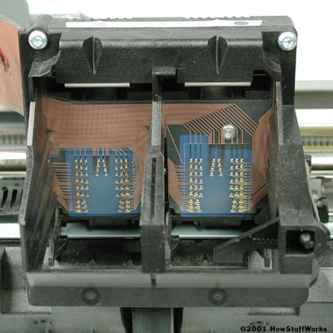
Inside an Inkjet Printer
Parts of a typical inkjet printer include:
1.Print head assembly
Print head :The core of an inkjet printer, the print head contains a series of nozzles that are used to spray drops of ink.

Slide 5
2.Paper feed assembly
Paper tray/feeder :Most inkjet printers have a tray that you load the paper into. Some printers dispense with the standard tray for a feeder instead.
The feeder typically snaps open at an angle on the back of the printer,
allowing you to place paper
in it. Feeders generally do not
hold as much paper as
a traditional paper tray.

Slide 6
3.Power supply :
While earlier printers often had an external transformer, most printers sold today use a standard power supply that is incorporated into the printer itself.
4.Interface ports:
The parallel port is still used by many printers, but most newer printers use the USB port. A few printers connect using a serial port or small computer system interface (SCSI) port.

Slide 7
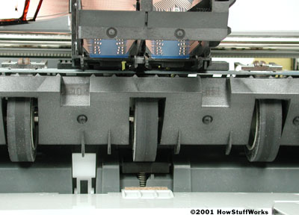
5.Control circuitry:
A small but sophisticated amount of circuitry is built into the printer to control all the mechanical aspects of operation, as well as decode the information sent to the printer from the computer.
The mechanical operation of the printer is controlled by a small circuit
board containing
a microprocessor and
memory.

Slide 8
Impact vs. Non-impact
There are several major printer technologies available. These technologies can be broken down into two main categories with several types in each:
Impact :These printers have a mechanism that touches the paper in order to create an image. There are two main impact technologies:
-Dot matrix printers use a series of small pins to strike a ribbon coated with ink, causing the ink to transfer to the paper at the point of impact.

Slide 9
-Character printers are basically computerized typewriters. They have a ball or series of bars with actual characters (letters and numbers) embossed on the surface. The appropriate character is struck against the ink ribbon, transferring the character's image to the paper.

Slide 10
Non-impact :
These printers do not touch
the paper when creating an
image. Inkjet printers are part
of this group, which includes:
-Inkjet printers, which are described in this article, use a series of nozzles to spray drops of ink directly on the paper.
-Laser printers, covered in-depth in How Laser Printers Work, use dry ink (toner), static electricity, and heat to place and bond the ink onto the paper.

Slide 11
  Solid ink printers contain sticks of wax-like ink that are melted and applied to the paper. The ink then hardens in place.
  Dye-sublimation printers have a long roll of transparent film that resembles sheets of red-, blue-, yellow- and gray-colored cellophane stuck together end to end. Embedded in this film are solid dyes corresponding to the four basic colors used in printing: cyan, magenta, yellow and black (CMYK). The print head uses a heating element that varies in temperature, depending on the amount of a particular color that needs to be applied. The dyes vaporize and permeate the glossy surface of the paper before they return to solid form. The printer does a complete pass over the paper for each of the basic colors, gradually building the image.

Slide 12
  Thermal wax printers are something of a hybrid of dye-sublimation and solid ink technologies. They use a ribbon with alternating CMYK color bands. The ribbon passes in front of a print head that has a series of tiny heated pins. The pins cause the wax to melt and adhere to the paper, where it hardens in place.
  Thermal autochrome printers have the color in the paper instead of in the printer. There are three layers (cyan, magenta and yellow) in the paper, and each layer is activated by the application of a specific amount of heat. The print head has a heating element that can vary in temperature. The print head passes over the paper three times, providing the appropriate temperature for each color layer as needed.

Slide 13
Thank you for attentions

